Slide 1
Expert Clinicians’ Prototypes of an Adolescent Treatment: Common and Unique Factors Among Four Treatment Models
Geoff Goodman, Ph.D.
Clinical Psychology Doctoral Program
Long Island university, Brookville, ny

Slide 2
Which Processes Make Adolescent Psychotherapy Work?
A. Therapy is effective for children and adolescents (Hanley & Noble, 2017)
B. Less is known about the processes that contribute to therapeutic success
C. What contributes to adolescent psychotherapy process in four popular treatment models?
1. how do you define each treatment model?
2. which processes are common to all treatment models and which processes are unique to each treatment model?
3. we believe that mentalization is a common process factor
A. ability to “read others’ minds”
B. interpretation of behavior as resulting from underlying mental states (e.g., intentions, beliefs, feelings)

Slide 3
Adolescent Psychotherapy Q-Set (APQ)
A. Definition of psychotherapy process restricted to a vocabulary of 100 items characterizing process
1. common vocabulary to articulate different types of process
2. arrangement of items can serve as operational definition of a treatment model’s process
B. Q-methodology mechanics
1. 100 items distributed in nine piles, forming a normal distribution (5-8-12-16-18-16-12-8-5)
2. APQ applied to full 45-minute audio-recorded or video-recorded sessions
3. APQ applied to sessions of adolescents ages 12-18
4. three categories of items
A. therapist attitudes and behaviors (1/3)
B. patient attitudes and behaviors (1/3)
C. therapist- patient interactions (1/3)

Slide 4
Adolescent Psychotherapy Q-Set (APQ) Continued…
5. convergent and discriminant validity shown with Hilsenroth’s Comparative Psychotherapy Process Scale (CPSS)
6. we collected prototypical APQ distributions from 39 expert clinicians (PDT, CBT, MBT, and IPT)
A. rate items “as you see this process occurring within a prototypical adolescent psychotherapy session from your theoretical perspective”
B. honorarium of $150 (funded by IPA grant)
7. ratings from each treatment model were composited by summing them and dividing by the number of raters

Slide 5
Results
A. Good internal agreement among four different groups of expert clinicians
B. Q-factor analysis suggested some variability in prototypical PDT (five-factor solution)
1. three PDT raters aligned with one IPT rater and one MBT rater
2. five PDT raters loaded onto their own unique factor
3. two PDT raters aligned with one CBT rater, one IPT rater, and seven MBT raters
C. PDT positively correlated with CBT (contrary to expectations)
D. MBT positively correlated with other three treatment model prototypes (but all treatment models intercorrelated)—MBT had highest mean correlation (r = .77)
E. Three partial correlations demonstrated that MBT accounts for significant correlations between PDT and CBT and between PDT and IPT, but not between CBT and IPT

Slide 6
Discussion
A. MBT process could not account for correlation between CBT and IPT (see Tables 1 and 2)
B. We proposed two common process factors
1. providing mentalization
2. providing support--advocating for pt.; cheerleading; guidance
C. Operational definitions of PDT, CBT, MBT, and IPT (see Tables 3-6)

Slide 7
Discussion continued
D. Significant intercorrelations found in child therapy prototypes but not adult therapy prototypes (contrary to expectations)
1. adolescent treatments more similar than different due to common factors
2. less talk therapy in adolescent therapy than adult therapy?
E. Which therapy process—mentalization or support—is more effective for which adolescents under which conditions?
1. calculate magnitude of adherence in clinic sessions
2. correlate these adherence scores with outcome measures
3. which treatment models are most effective for which patients for how long?

Slide 8
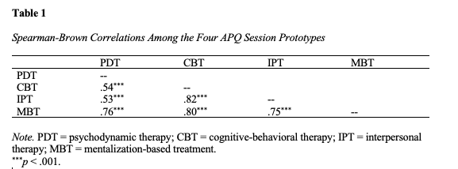

Slide 9
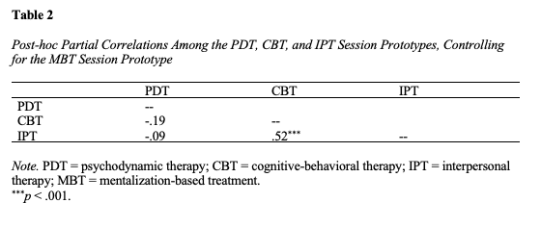

Slide 10
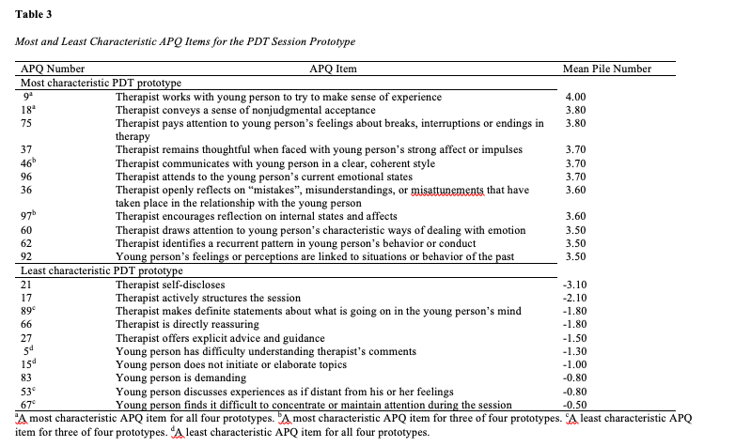

Slide 11
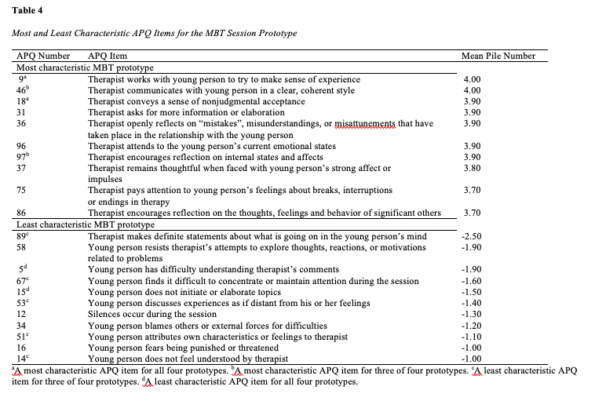

Slide 12
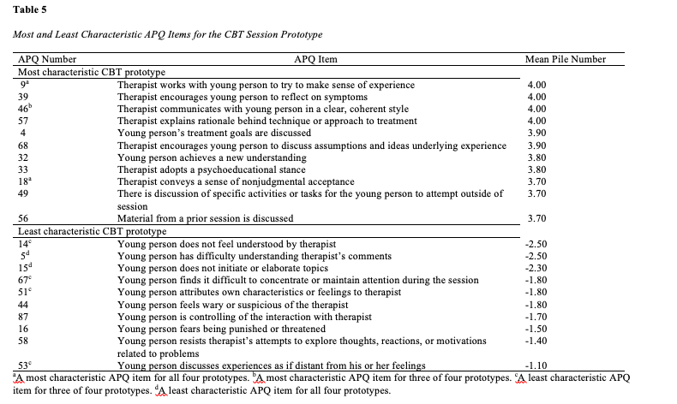

Slide 13
