Slide 1
CAFTR Membership Survey
Aimed to collect information about the members of the list-serve to facilitate collaboration among us.
When you sign-up, you can also fill out the survey:
https://pt.surveymonkey.com/r/6XWVMQX

Slide 2
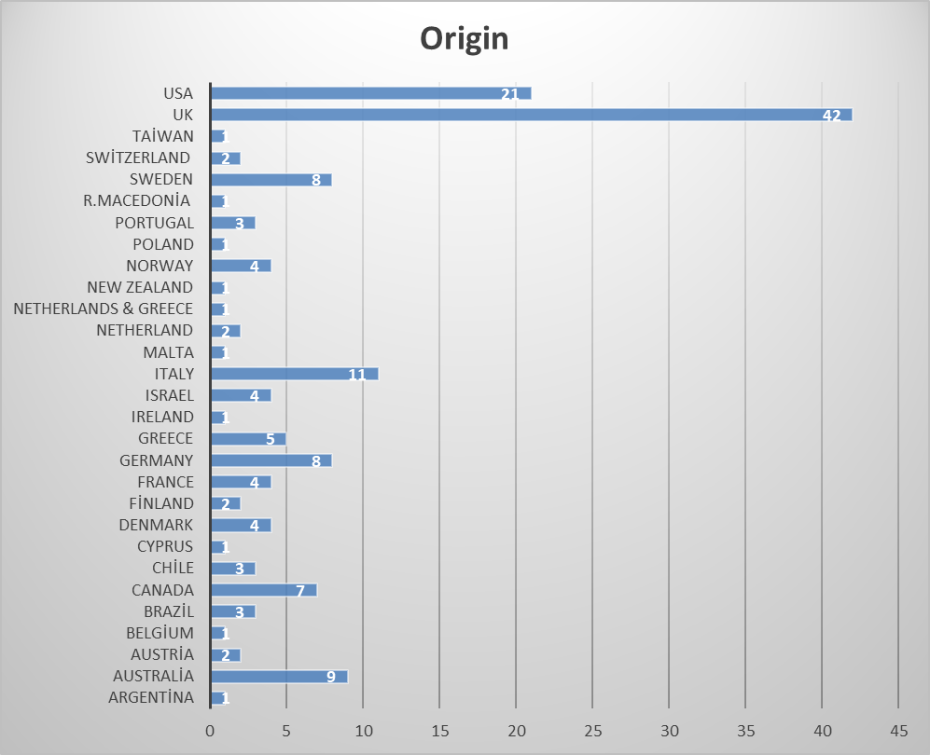
Membership Survey (May 2020) Participant Origin

Slide 3
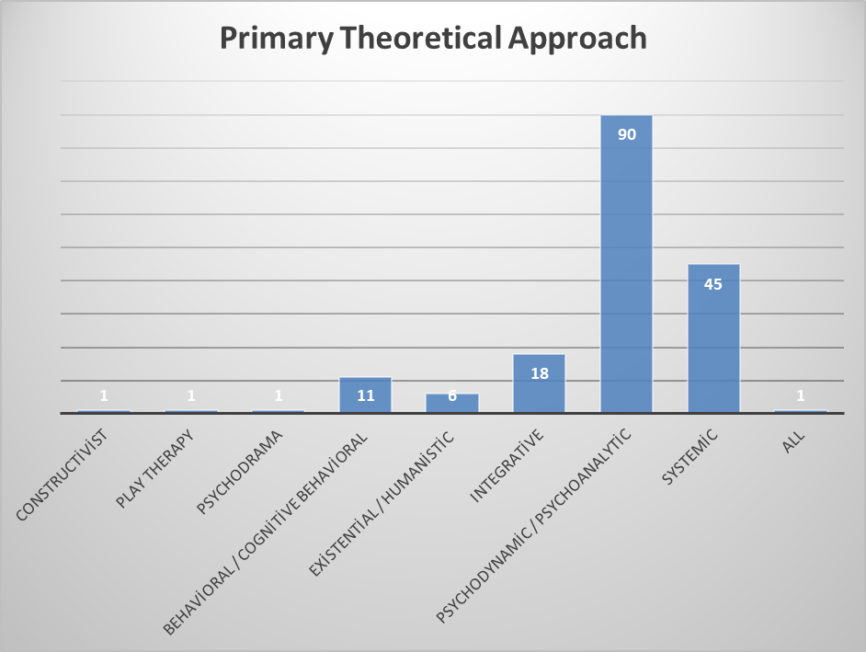
Membership Survey (May, 2020) Theoretical Orientation

Slide 4
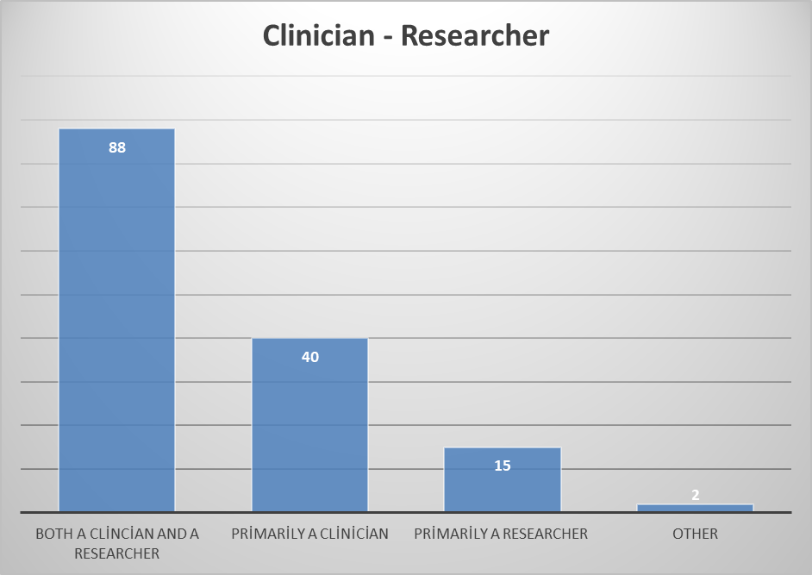
Membership Survey (May, 2020) Research Activity

Slide 5
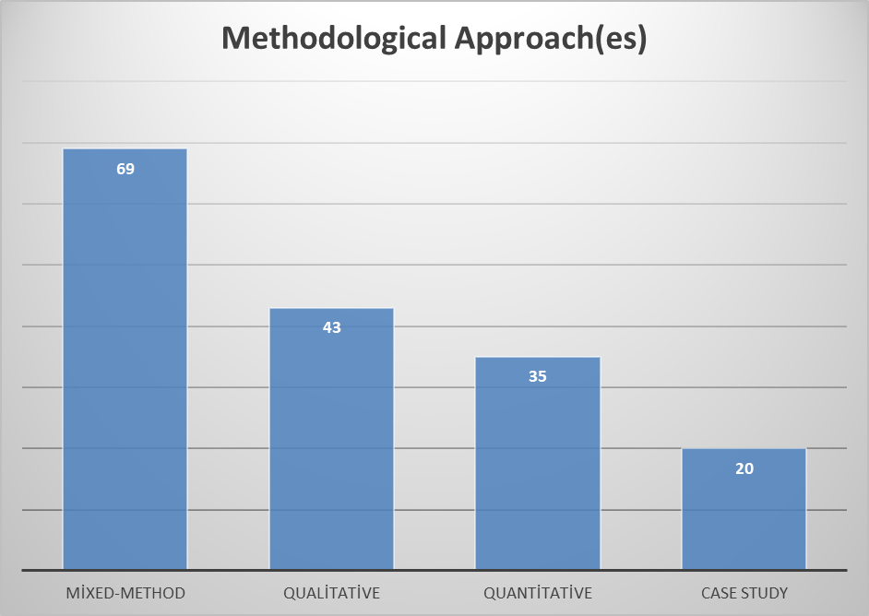
Membership Survey (May, 2020) Methods Used

Slide 6
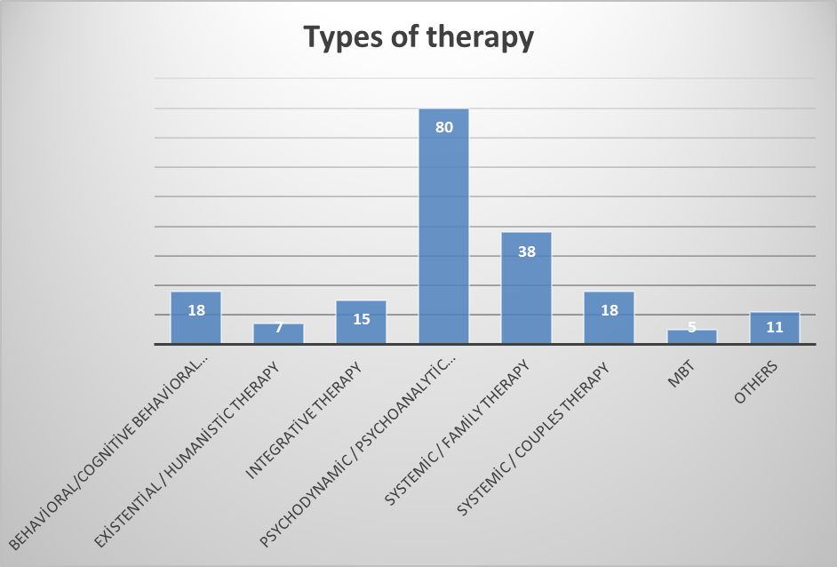
Membership Survey (May, 2020) Therapy Modality Researched

Slide 7
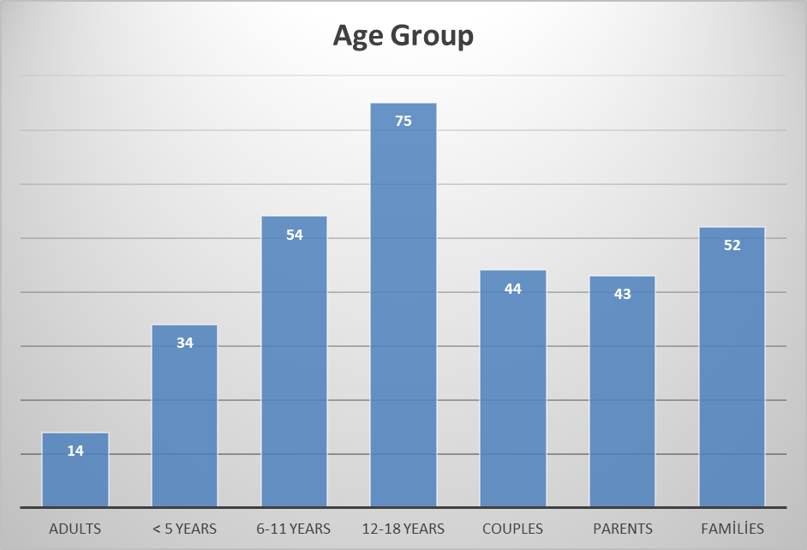
Membership Survey (May, 2020) Age Groups Researched

Slide 8
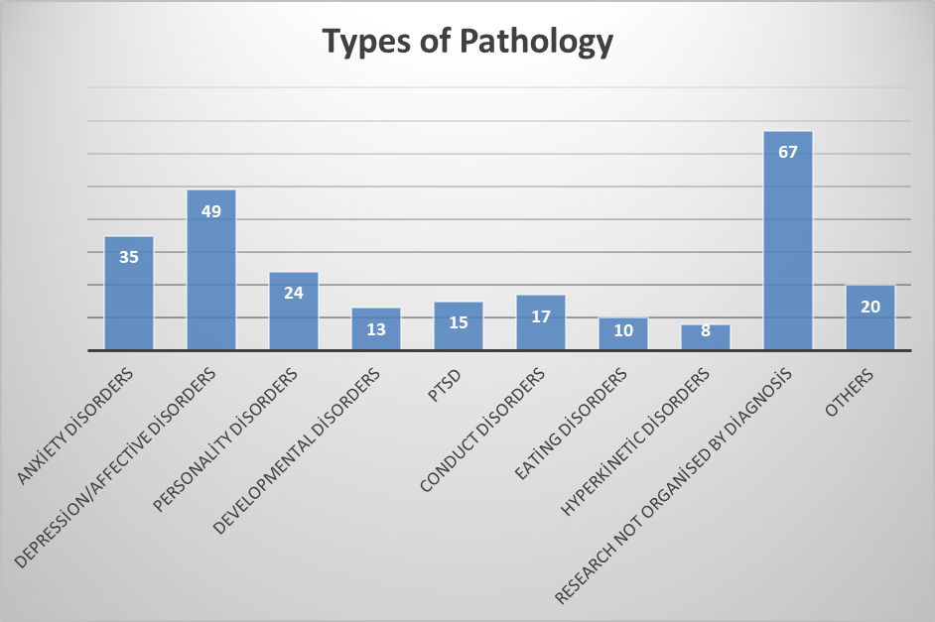
Membership Survey (May, 2020) Pathologies Researched

